Slide 1
TRUTH BE TOLD, Diamond in the Rough!
Press football
for highlight
→→
ROMEEL COCHRAN
6 feet 3, 235 pounds class 2015
2.8 GPA and 16 on Act
Olive Branch High School Mississippi
Positions: Tight end, H-Back, Slot. Defensive End
“The first ball that was thrown to me, as a baby, I caught it”
First let me personally thank you for taking the time to look at my bio. Played Youth Football at Detroit PAL 6 years captain all years and Defensive MVP all years. Craigmount High School, Memphis TN, Sophomore year First team ALL District Tight End Played varsity basketball, and varsity and JV Baseball right field. Olive Branch High School first ever Starting Tight End in school history junior year. Played AAU Youth Basketball in Detroit from 5 years old 13, 7 - 8th grades MVP’s, captain most years. Played high school AAU in Memphis. Over all GPA 2.8, This semester’s progress report 3 A’s and a B Throughout majority of school years many Academic and citizenship awards.

Slide 2
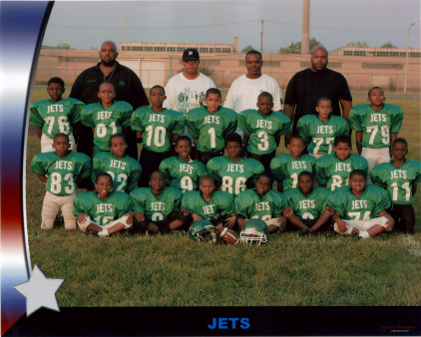
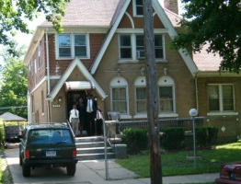
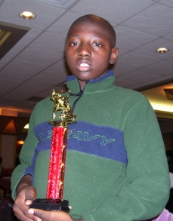
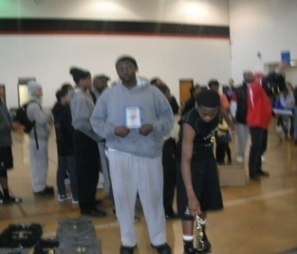
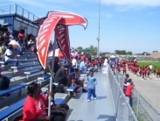
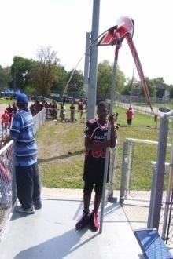
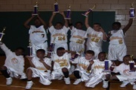
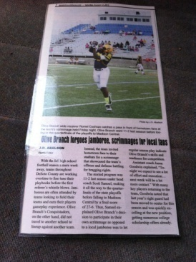
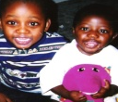
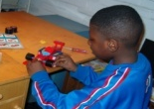
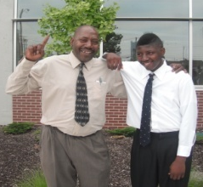
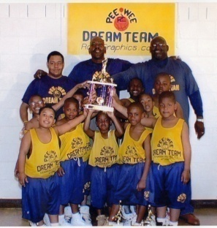
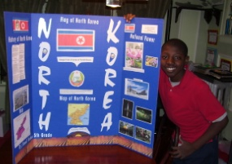
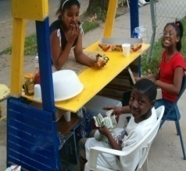
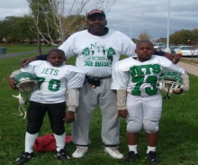
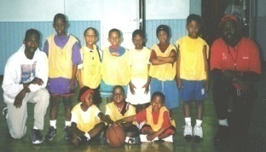
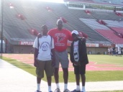
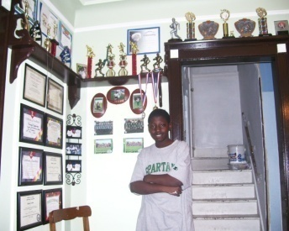
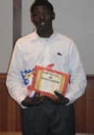
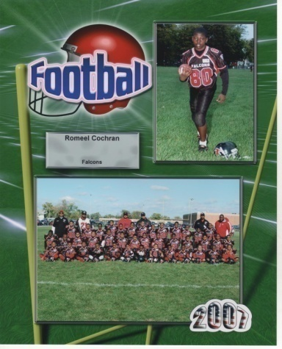
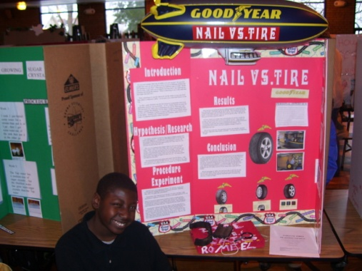
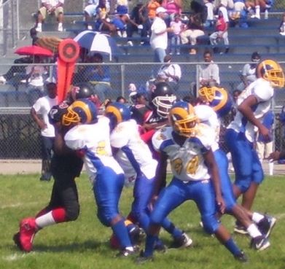
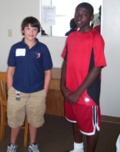
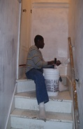
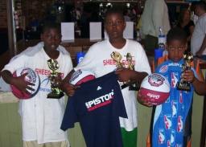
Romeel Cochran’s Life Time Line “It’s All GOOD!”

Slide 3
Romeel Cochran’s HIGHLIGHTS

